Slide 1
MLDA
Deep Multi-type Objects Multi-view Multi-instance Multi-label Learning
Yuanlin Yang^{1,2}, Guoxian Yu^{1,2,*}, Carlotta Domeniconi³ and Xiangliang Zhang⁴
¹Southwest University, Chongqing, China
²Shandong University, Jinan, China
³George Mason University, VA, USA
⁴King Abdullah University of Science and Technology, Thuwal, SA
Machine Learning and Data Analysis Lab
*www.mlda.swu.edu.cn (gxyu@sdu.edu.cn)

Slide 2
1
Background
2
Related Work
目
录
3
DeepM4L
CONTENTS
4
Experiments
Notes:
我将从以下几个方面进行阐述。

Slide 3
Background
Complex object
Multi-view Multi-instance Multi-label data
Import concept:
Bag are composed of multi-instance.
Instance represents heterogeneous feature vector .

Slide 4
M3L^{[1]}
Multi-view Multi-instance Multi-label Learning(M3L)
However, M3L still focuses on single-type objects, and lacks the ability to jointly model multi-types of objectss.
Purpose:
To obtain the label information of a sample by learning the feature of the instance contained in multiple views.
[1]Y. Xing, G. Yu, C. Domeniconi, J. Wang, Z. Zhang, and M. Guo, “Multi-view multi-instance multi-label learning based on collaborative matrixfactorization,” in AAAI , 2019, pp.5508–5515.

Slide 5
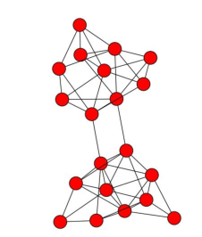
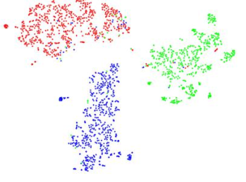
Network Embedding
Embed each node of a network into a low-dimensional vector space
generate
embed
G = ( V )
Low-dimensional Vector Space
The nodes in the network are represented by a low-dimensional dense vector space (where the dimension of the vector space is much smaller than the total number of nodes), and the original network structure and characteristics can be maintained, and then input into the relevant algorithm to complete the node classification , link prediction and network visualization tasks.
G = ( V, E )

Slide 6
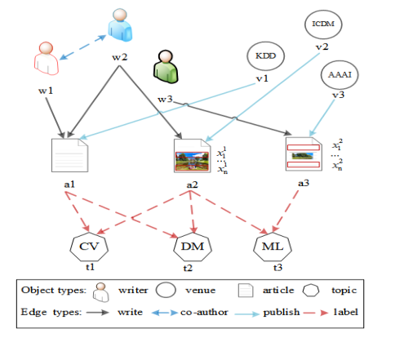
Traditional modeling ideas
Path-based：
DeepWalk[1]
Metapath2vec[2]
GraphInception[3]
CNN-based(CNN to graph CNN)：
Spectral methods[4]
Spatial methods[5]
[4] M. Defferrard, X. Bresson, P. Vandergheynst. Convolutional neural networks on graphs with fast localized spectral filtering. NeuraIPS, 2016.
[5]W. L. Hamilton, R. Ying, J. Leskovec. Inductive Representation Learning on Large Graphs. NeuraIPS 2017.

Slide 7
Convolutional neural network(GCN)
Spectral methods：
Define convolution in spectral domain
Convolution is defined via graph Fourier transform and convolution theorem.
The main challenge is that convolution filter defined in spectral domain is not localized in vertex domain.
Spatial methods：
Define convolution in the vertex domain
Convolution is defined as a weighted average function over all
vertices located in the neighborhood of target vertex.
The main challenge is that the size of neighborhood varies
remarkably across nodes.

Slide 8
Related Work
M3L：
M3Lcmf[6]
M2IL[7]
ICM2L[8]
M3L or lower version considers single type of object, and obtains limited information. It cannot naturally extend to heterogeneous networks.
Network Embedding ：
DeepWalk
matapath2vec
GraphInception
GraphHeat[9]
The network embedding method considers the network structure in the heterogeneous (homogeneous) network in order to obtain a suitable embedding representation of the node. But it didn't consider the multi-instance setting like the complex object (bag), and treated it as a simple node.
[9]B. Xu, H. Shen, Q. Cao, K. Cen, X. Cheng. Graph Convolutional Networks using Heat Kernel for Semi-supervised Learning, IJCAI 2019.

Slide 9
M4L in HIN
Challenges
Challenge1: HNE and NE solutions consider complex objects as simple network nodes but ignore the instance-level subobjects,and current HNE and NE solutions are difficult to directly apply for multi-instance data.
Challenge2: The same bag across views can have varying instances and how to ensure the label consistency between a bag and its affiliated instances within/between views is a non-trivial job.
Challenge3: The previous matrix factorization methods(M4L-JMF and M3Lcmf)can only learn a linear representation with respect to a small number of objects.

Slide 10
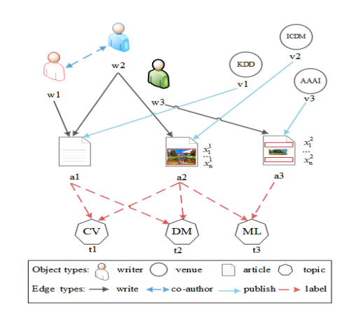
Idea
Step 1: Apply an instance embedding network to encode the inter- and intra-relations among multi-type bags. Then learn the composite representation feature vectors of instances and bags embedded in the HNE space (For Challenge 1 and 3).
Step 2: Apply orginal label subspace to fuse the label score tensor of the multi-view bag to predict bag-level and instance-level labels in a coherent fashion (For Challenge 2).
An illustration of Multi-type Multi-view Multi-instance Multi-label(M4) data of four types (author, venue, paper and topic).

Slide 11
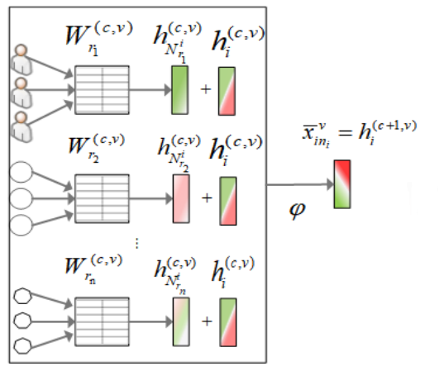
Workflow
Instance Neighbor Embedding
we consider the first-order neighbors of a node to gather and disseminate information as follows:
where is a set of neighborhood nodes of i for relation type r
ϕ is an activation function

Slide 12
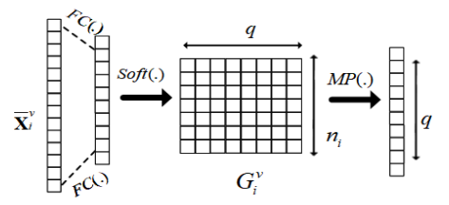
Workflow
Instance Label Tensor Column-wise Max-pooling
FC(·) means the full connection operation, Soft(·) means softmax operation, and MP(·) is the column-wise max-pooling operation.
Unify the instance-label to bag label
Predict the labels of bags
where denotes the view- dependent reconstruction error for the v-th view.
is the bag-label ground truth across all views.

Slide 13
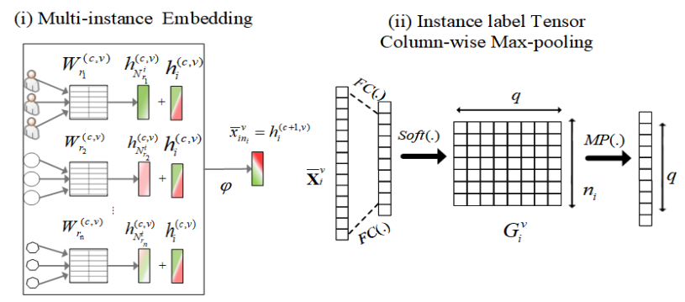
Workflow
Objective Function of DeepM4L
Calculate the
instance level labels prediction loss
Integrate bag-label tensors across views

Slide 14
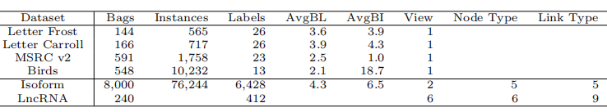
Experiments
Datasets
Statistics of datasets used for the experiments. avgBL is the average number of labels per bag and avgBI is the average number of instances per bag
[1] G.Yu, et. al. Isoform function prediction based on bi-random walks on a heterogeneous network, Bioinformatics, 2020.
[2] G. Fu , et. al. Matrix factorization-based data fusion for the prediction of lncrna–disease associations, Bioinformatics, 2018.

Slide 15
Baselines
M3L
Data Fusion(DF)
M3Lcmf(AAAI,2019)
M2IL(TPAMI,2017)
ICM2L(CYB,2020)
DFMF(TPAMI,2015)
SelDFMF(DASFAA,2019)
Network Embedding (NE)
Metapath2vec(SIGKDD,2017)
GraphHeat(IJCAI,2019)
[1]Yuying Xing, Guoxian Yu, Carlotta Domeniconi, Jun Wang, Zili Zhang, Maozu Guo:Multi-View Multi-Instance Multi-Label Learning Based on Collaborative Matrix Factorization. AAAI 2019.
[2]B. Li et al., Multi-View Multi-Instance Learning Based on Joint Sparse Representation and Multi-View Dictionary Learning, in TPAMI, 2017.
[3]Qiaoyu Tan, Guoxian Yu, Jun Wang, Carlotta Domeniconi, and Xiangliang Zhang. Individuality-and commonality-based multiview multilabel learning. IEEE T. on CYB, 99(1):1–13, 2020.
[4]Žitnik M, Zupan B. Data fusion by matrix factorization. TPAMI, 2014, 37(1): 41-53.
[5]Yuehui Wang, Guoxian Yu, Carlotta Domeniconi, Jun Wang, Xiangliang Zhang, Maozu Guo. Selective Matrix Factorization for Multi-Relational Data Fusion, DASFAA, 2019.
[6]Dong, Y.; Chawla, N. V.; and Swami, A. metap-ath2vec: Scalable representation learning for heterogeneous networks. In SIGKDD, 2017
[7]B. Xu, H. Shen, Q. Cao, K. Cen, X. Cheng. Graph Convolutional Networks using Heat Kernel for Semi-supervised Learning, IJCAI 2019.

Slide 16
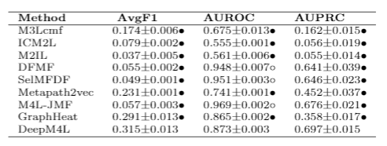
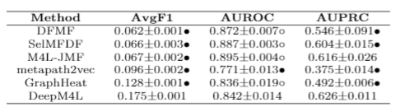
Experiments
Results on Isoform:
Results on LncRNA:

Slide 17
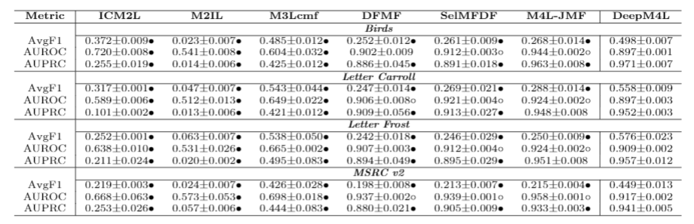
Experiments
M3 Results on Bag-level:

Slide 18
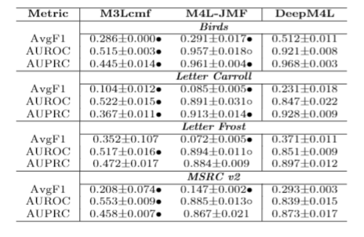
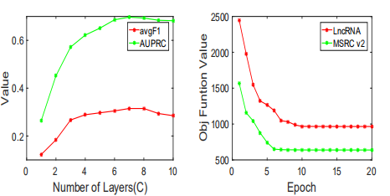
Experiments
M3 Results on Instance-level:
Parameter Sensitivity Analysis:

Slide 19
Experiments
Conclusion
we studied a novel learning method (Deep Multi-typed objects Multi-view Multi-instance Multi-label Learning) for naturally interconnected multi-typed complex objects. DeepM4L can more comprehensively fuse multi-typed objects and mine complex relations between bags, instances and labels, and it achieves better results than
other competitive and related methods.
Future work
Meta-learning, Few-shot learning and Zero-shot learning..etc to resolve large training data problem.

Slide 20
Reference
[1]Perozzi, B.; Al-Rfou, R.; and Skiena, S. Deepwalk:online learning of social representations. In SIGKDD, 2014
[2]Dong, Y.; Chawla, N. V.; and Swami, A. metap-ath2vec: Scalable representation learning for heterogeneous
networks. In SIGKDD, 2017
[3]Yizhou Zhang, Yun Xiong, Xiangnan Kong, Shanshan Li, Jinhong Mi, Yangyong Zhu. Deep Collective Classification in Heterogeneous Information Networks. WWW 2018.
[4] M. Defferrard, X. Bresson, P. Vandergheynst. Convolutional neural networks on graphs with fast localized spectral filtering. NeuraIPS, 2016.
[5]W. L. Hamilton, R. Ying, J. Leskovec. Inductive Representation Learning on Large Graphs. NeuraIPS 2017
[6]Yuying Xing, Guoxian Yu, Carlotta Domeniconi, Jun Wang, Zili Zhang, Maozu Guo:Multi-View Multi-In
stance Multi-Label Learning Based on Collaborative Matrix Factorization. AAAI 2019.
[7]B. Li et al., "Multi-View Multi-Instance Learning Based on Joint Sparse Representation and Multi-View Dictionary Learning," in TPAMI, 2017.
[8]Qiaoyu Tan, Guoxian Yu, Jun Wang, Carlotta Domeniconi, and Xiangliang Zhang. Individuality-and commonality-based multiview multilabel learning. IEEE T. on CYB, 99(1):1–13, 2020.
[9]B. Xu, H. Shen, Q. Cao, K. Cen, X. Cheng. Graph Convolutional Networks using Heat Kernel for Semi-supervised Learning, IJCAI 2019.
[10]T. N. Kipf, and M. Welling. Semi-supervised classification with graph convolutional networks. ICLR 2017

Slide 21
MLDA
Thanks！

